Slide 1


January 2017 USPS® Rate Change
- What You Need To Know

Slide 2

Adam Lewenberg - Background and Experience
President of Postal Advocate Inc.
  The only mail audit and recovery firm in the US and Canada
  Manage a portfolio of over 61,000 pieces of mailing equipment for the largest US companies.
  Speak and teach nationally on mail savings and industry trends.
Industry Co Chair- Boston Postal Customer Council/Mail Systems Management Association member. CMDSS and MDC Certifications.
Featured Writer for Mailing Systems Technology Magazine.
Worked for one of the largest mailing vendors for over 18 years
  Director of national sales for presort, tabletop inserters, addressing hardware/software and green offerings.
  Was one of the top 5 account managers nationally working with some of the nations top accounts.
Not affiliated with any mailing vendor - Unbiased advice.

Slide 3
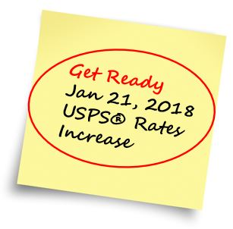
January 2018 USPS® Rate Change – Proposed
- What You Need To Know
Speaker: Adam Lewenberg
President of Postal Advocate Inc.

Slide 4
What We’ll Cover:
What rates are changing
How this impacts you
What you need to do
Savings tips
New rates take into effect Sunday January 21, 2018
We will focus on the most common rate structures. For more detail on other mail classes and services go to USPS Postal Explorer at http://pe.usps.gov/PriceChange/Index

Slide 5
First-Class Mail® Single Piece
1-21% Increase
Price of a stamp is increasing from $0.49 to $0.50 – 2% increase
No price increase to the additional ounce rate so the % gets smaller as items gets heavier.
Flats increasing from $.98 to $1.00 – It is still 2 stamps.
Parcels are going up the most because of growth in this segment.

Slide 6
First-Class Mail® Single Piece - The Good News
Using a postage meter or a PC postage will have a price increase from $0.46 to $0.47.
Metered mail (including PC Postage) will still save $.03 per piece over stamps purchased from the Post Office!
Savings over First-Class Mail® Retail @ $.50 each
Postage meters and PC Postage start at about $20 per month and can make your mail easier to manage.

Slide 7
First-Class Mail® Commercial
6% Decrease to 6.3% Increase
The spread of automation discounts is larger.
  Single piece rates went up by $.01 but automation rates only increased by $.001-.005.
In 2017 the Weight limit for the Letter rates went from 2 to 3.5 ounces
Flats had the biggest changes.
  5 Digit went up by $.028
  3 Digit, AADC and Mixed AADC went down by $.037-.045
  Presorted rates stayed about the same ($.001 increase)
Full Service IMB customers still qualify for the additional $.003 savings.

Slide 8
First-Class Mail® Savings Options - Letters
3-ounce Metered Letter at $0.91 to a Commercial rate of $0.378 – 58% savings!
For flat (9x12 or 10x 13), consider folding them into a 6x9 envelope
3-ounce flat at $1.42, could cost only $0.378 assuming it could be automated through in-house software or presort services
Automation Mail can now add extra content at no additional charge!

Slide 9


Converting Light Weight Flats to Letters
Light Weight Flats
  Look for average flat prices of $1.42 or less. Over 50% Savings by folding.
  6X9 Envelopes only require that you fold in half.

Slide 10
Marketing Mail® (Formerly called Standard Mail)
7% Decrease to 8.7% Increase
Offers a larger savings compared to First-Class
Flats are seeing the highest increases and decreases.

Slide 11
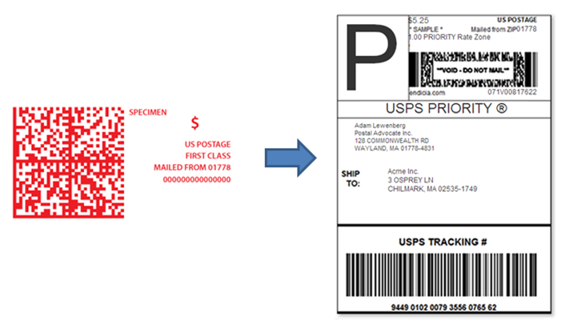
Priority Mail Rate Categories
Retail – At USPS Counter or through a postage meter.
Commercial Base – Through a PC Postage Solution (USPS.com will no longer qualify for these rates and will default to retail)
Commercial Plus – Through a contracted agreement with the USPS.
  Priority Mail® - 50,000 packages per year across facilities

Slide 12
Priority Mail®
Most popular USPS package service
13 ounce to 70LB items 1-3 day delivery throughout the US
9 primary zones based on distance.
Highlights
1% Decrease to 10% Increase
Flat rate items are seeing the largest overall increases.
If you are running Priority Mail® items at Retail rates using Click-N-Ship® or a postage meter, consider switching to a PC Postage solution that utilizes Commercial rates which saves 11% overall and ranges from 3-39% based on weight and zone
Contact the USPS if you are sending out over 50,000 packages per year for Plus Rates.

Slide 13
Priority Mail® Express
Up to 70LB items 1 day Guaranteed Delivery
9 primary zones based on distance.
Highlights
3-10% Increase (Depending on Weight and Zone)
Retail rates increased 6% overall but 9% for Flat Rate and less than 10LB items.
Commercial rates increased 4% overall but 5% for Flat Rate and less than 10LB items.
Commercial Plus rates are the same as Commercial Base.

Slide 14
Savings Tips - Move to Commercial Rates
Huge discounts over retail rates.
Free tracking on usps.com.
Need to process through a PC Postage solution to get the discounts.
Multiple vendor options to process packages
Requires the operator to enter the address and submit to the USPS electronically and create a shipping label vs. meter tape.
10% Average Savings
12% Average Savings

Slide 15
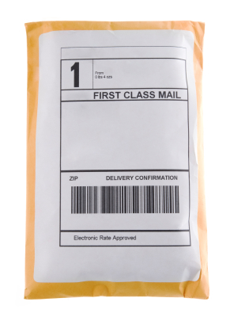
First-Class Mail® Package Service
Best Savings Opportunity
Less than 1 LB parcels where USPS holds a Monopoly (Private carriers start at 1LB)
1-3 day delivery
Highlights
1 to 15% Increase
Greatest increase – As items get heavier with 15.99 ounces prices going up to 15%
Save by converting from Retail to Commercial with improved tracking!

Slide 16
Additional Rate Change Items

Slide 17
Special Services

Slide 18
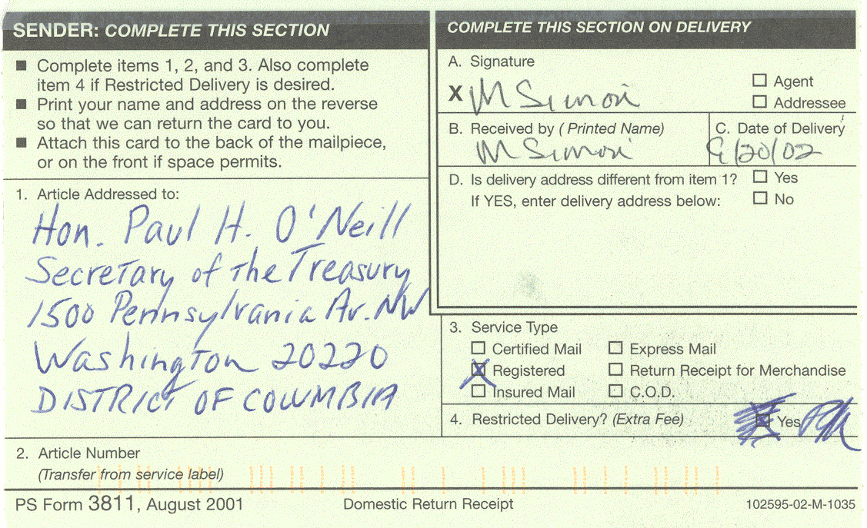
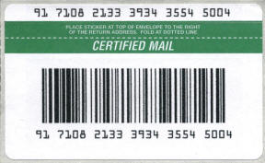
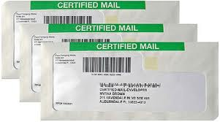
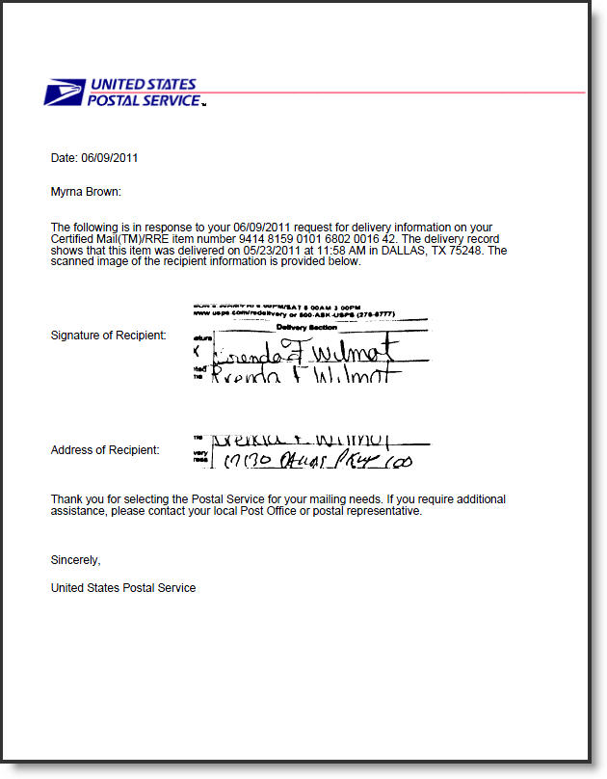
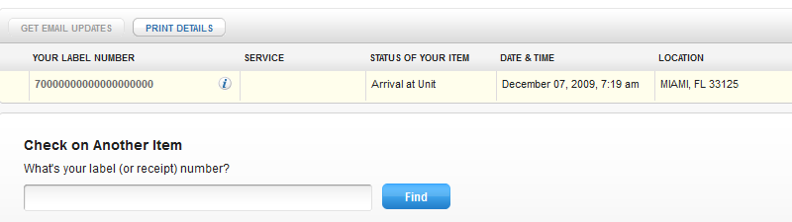
Certified Mail with Electronic Return Receipt (ERR)
  Save $1.25 by switching to an electronic version.

Slide 19
Savings Tips
Compare Rates with the Private Carriers - For every package
Benefits to USPS
Don’t charge extra fees for:
  Fuel surcharge
  Residential, DAS Surcharges
  Saturday Delivery
  Address Correction Fees
Best rates for lightweight items to residences (Less than 5 LB’s)
First Class Parcel rates for items less than 16 ounces. ($2.66-4.94 per item!)
Free boxes
Benefits UPS & FedEx*
Negotiate rates based on volumes.
Guaranteed delivery with refunds.
Ground service with 1-5 day guaranty(Many areas are 1-3 days).
Dedicated account managers.
Typically have the best rates items over 5LB’s or lighter weights going to businesses.
*Assumes that you have a corporate agreement.
Multi Carrier options:
Manually compare between systems.
Cloud based multi carrier systems – simple to complex.
PC/Server based multi carrier systems.

Slide 20
How To Budget For This Increase
Enter last years spend.
Estimate % based on type of mail.
Below is an example on how to set this up.
Tip: If you are seeing your mix of mail having a higher percentage increase, edit this on the template.

Slide 21
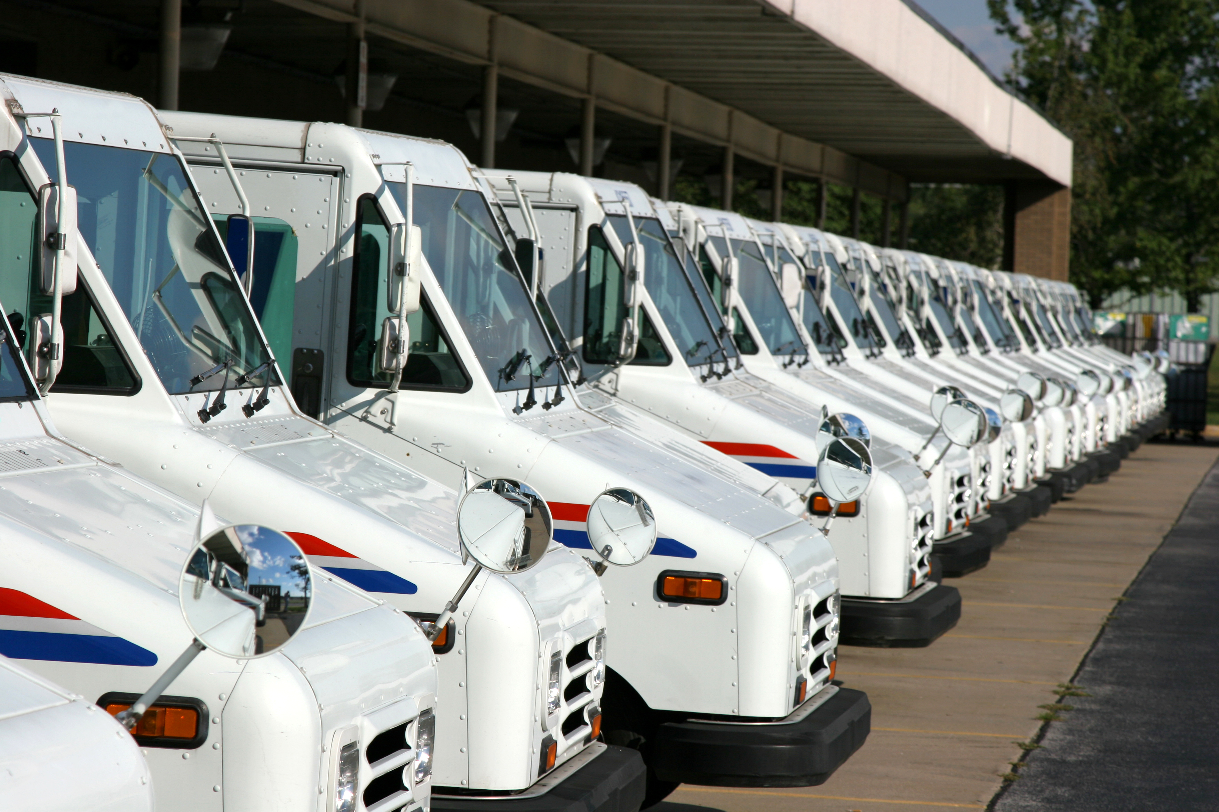
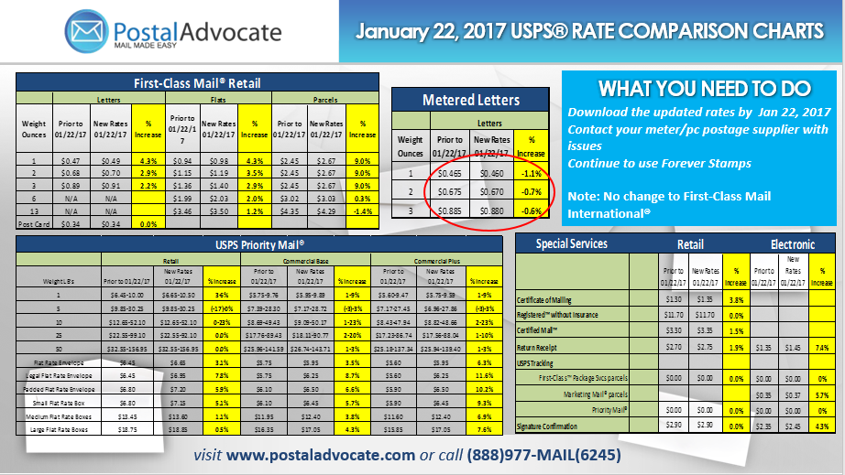
What you need to do:
If you have a mail machine, make sure you download the new rates before January 21, 2018 when the rates take into effect to take full advantage of the decrease.
Here are links to the different meter vendors:
  Pitney Bowes:
  http://www.pitneybowes.com/us/postal-information/rate-change-info.html
  Neopost/Hasler:
  http://www.neopostusa.com/resources/rate-change-information
  FP:
  http://www.fp-usa.com/ratechange/
  Stamps.com:
  https://stamps.custhelp.com/app/answers/detail/a_id/1685/~/january-2017-usps-rate-changes
Go to the USPS Postal Explorer website for more information:
http://pe.usps.gov/PriceChange/Index
Download the Postal Advocate Rate Comparison Guide – www.postaladvocate.com

Slide 22
Rate Summary
First-Class Mail® Single Piece – 1% to 21% Increase (2% avg for letters/flats)
First-Class Mail® Single Piece Metered Letters – $.03 savings over Retail and price is increasing from $.46 to $.47! (2% Increase)
First-Class Mail® Commercial – 6% Decrease to 6% Increase
  Base price level increased from 2 ounces to 3.5 ounces!
Marketing Mail® - 7% Decrease to 6% Increase
Priority Mail® - 0-14% Increase
Priority Mail® Express – 1 – 7% Increase
First-Class® Mail Package Service – 1% to 15% Increase

Slide 23
Savings Summary
Use a postage meter or PC Postage to save $.03 per letter.
Convert Letters and Flats to Automation Classes – up to 73% Savings!
  Up to 3.5 ounces for the price of 1 ounce!
  Fold flats for additional savings
  Faster delivery
  Automated address validation
Convert Priority Mail® from Retail to Commercial to Plus
  10% average savings for Priority Mail®
  12% average savings for Priority Mail® Express
Convert First-Class Mail® Parcels from Retail to Commercial – 15-59% Savings
User Electronic Return Receipt with Certified Mail - $1.25 Savings.
Compare pricing across carriers for the best rate on each package.

Slide 24







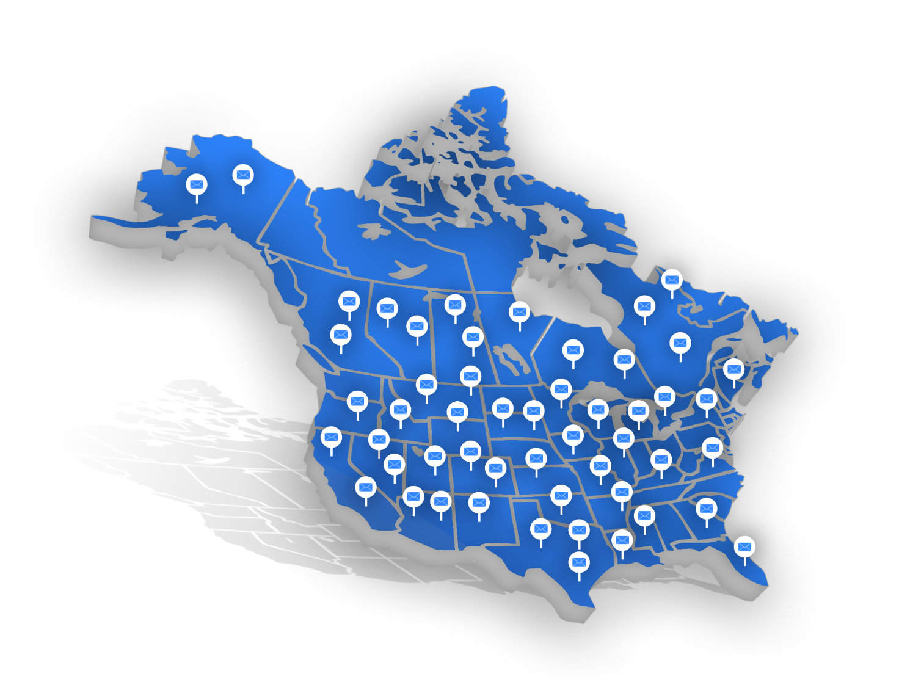




ENTERPRISE-WIDE MAIL AUDIT AND RECOVERY
OVER $34,000,000 IN CLIENT SAVINGS
Helping multi-location
organizations streamline
their mailing costs
60%
Over 93,000 pieces of
equipment, managed
by Postal Advocate
Average Equipment
Savings
$913K
Average Client
Savings
Risk-Free
No Cost Analysis!
HOW WE DO IT
240+ years of industry experience
Comprehensive web-based tool
providing visibility of all mail
and equipment spend
Time Savings - Assistance
in fleet management
Recovered over
$8,096,561
in lost postage, vendor
overcharges and fees
visit www.postaladvocate.com or call (888)977-MAIL(6245)

Slide 25









1
2
HOW IT
WORKS
Sign Limited Agency
Agreement/Kick-Off Call.
Provide copies of vendor
invoices, AP export,
location list,
equipment inventory list.
3
NO COST – AUDIT PHASE
CONTRACTED CLIENT
Work with current vendor to build population
report, contract terms/start/end dates,
postage volumes, costs.
Submit vendor credit requests,
lost postage forms and
eliminate avoidable fees.
Analyze spend, check for contract
compliance, billing errors, vendor
fees/overcharges, lost postage.
Negotiate pricing. Create catalog.
Work with locations -
asset validation, rightsize, termination…
Conduct Analysis
Identify savings opportunities.
Full implementation of savings.
4
5
6
Provide enterprise visibility of
all spend, costs and
documented savings
through enterpriseAdvocate.
Provide client log-in.
Postal Advocate provides
ongoing support,
manages renewals, billing
and vendor compliance.
Present savings opportunities
and get client approval.
visit www.postaladvocate.com or call (888)977-MAIL(6245)

Slide 26

Questions?
Contact: Adam Lewenberg - President
888-977-MAIL X 501
adam.lewenberg@postaladvocate.com

